Slide 1
Bonrix SMPP Gateway 1.0.1

Slide 2
Index
Introduction
Architecture diagram
Set up diagram
System & Software Requirements
Installation
Deployment
Operations
HTTP API
Settings
Features
Preconfigured-Users

Slide 3
Introduction
Bonrix SMPP Gateway is a J2EE web application.
Clients can connect to it by TCP-IP or can directly do request to an HTTP API.
It has Administrative web interface to manage users and SMS termination settings.
We can allow users to have credit and validity based or TPS(Transaction Per Second) access to the gateway.
It has three types of SMS termination mechanism
1) Drop SMS to our predefined directories.
2) Submit SMS to high performance messaging server
[Apache Active MQ Server 5.x(Free software)]
3) Directly forward SMS to third party HTTP API.
In backend for storing information it uses MySQL and Mongo DB as database servers. Both are freely available.
It can be deployed on any java application server.
For ex: Apache Tomcat , Jetty, JBoss, etc.

Slide 4


Architecture Diagram
Third Party SMPP Client
HTTP API
Bonrix SMPP Client
Bonrix SMPP Gateway
Third Party HTTP API
Active MQ Server
Directories
Bonrix SMPP Client
SMSC

Slide 5




Set Up Diagram
Clients
Bonrix SMPP Gateway
Windows /
Linux Machine
ActiveMQ Server
MySQL
Mongo DB
Third Party HTTP API
SMSC Connection

Slide 6
System & Software Requirements
Operating System
Windows XP, Windows 7, Windows 8,Linux,Mac,Solaris
RAM & CPU
Minimum 2GB RAM
Intel P4 or Higher
Hard Disk
80 GB or More
Software
JDK 1.6 or higher, Apache Tomcat Server, MySQL Server , mongo DB

Slide 7
Installation
Download demo version of Bonrix SMPP Gateway
Windows 32-bit machine
http://www.bonrix.co.in/smpp/32/smsc.zip
Windows 64-bit machine
http://www.bonrix.co.in/smpp/64/smsc.zip
Download and install JDK 6 from http://www.oracle.com/technetwork/java/downloads
Download and install Apache ActiveMQ 5.x from http://activemq.apache.org/
Download and install MySQL 5.x from http://www.mysql.com/downloads/

Slide 8
Deployment
=> Perform following steps during firs time installation only.
Extract smsc.zip. You will find 3 folders. One for tomcat and other for mongo DB and one for directory structure.
Double click on copy-directories.bat file. It will create necessary directory structure.
Create database named “smpp” in MySQL Server.
Register mongo DB as system service or start it from Command prompt.
Inside bin folder of mongo DB there are 3 windows batch files.
1) InstallAsService.bat –To register as windows service(once)
2) RemoveService .bat – Remove from windows services(once)
3) start-mongoDB.bat – To start mongo DB from command line[every time if do not register as a service].
Start Tomcat Server.
TOMCAT_HOME/bin/startup.bat

Slide 9
Operations
Start mongo DB if not registered as windows service.
Start the tomcat server
To access administrative console for users and SMS termination settings hit the following URL in browser.
http://localhost:8080/SMSC/
Click on Users link to mange users
Click on Settings link to manage settings for users
Click on Reports link to search or download delivery reports.
Few Screen shots are given in following slides.

Slide 10
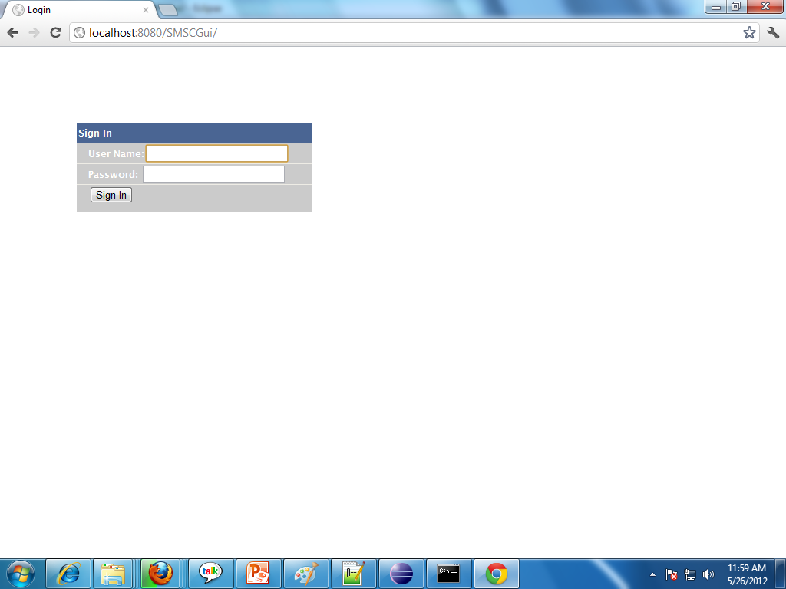
Login

Slide 11
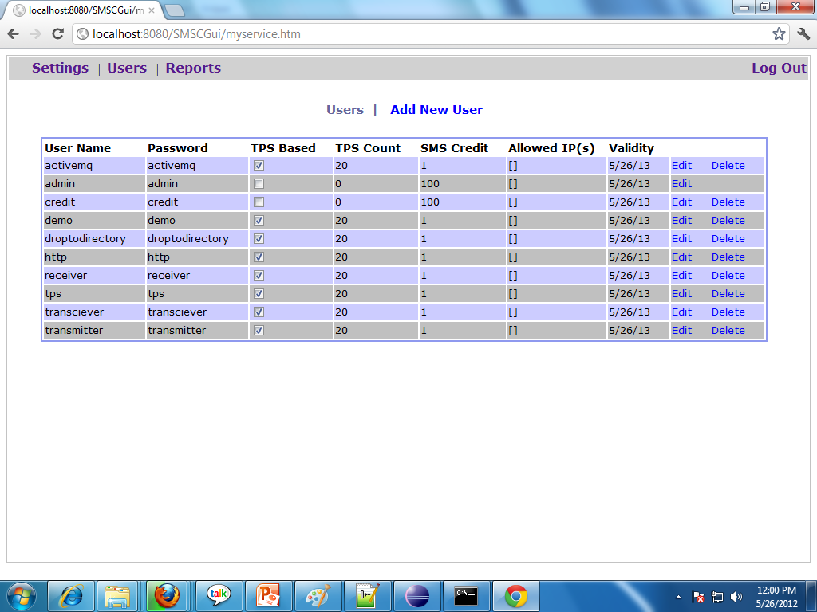
Users

Slide 12
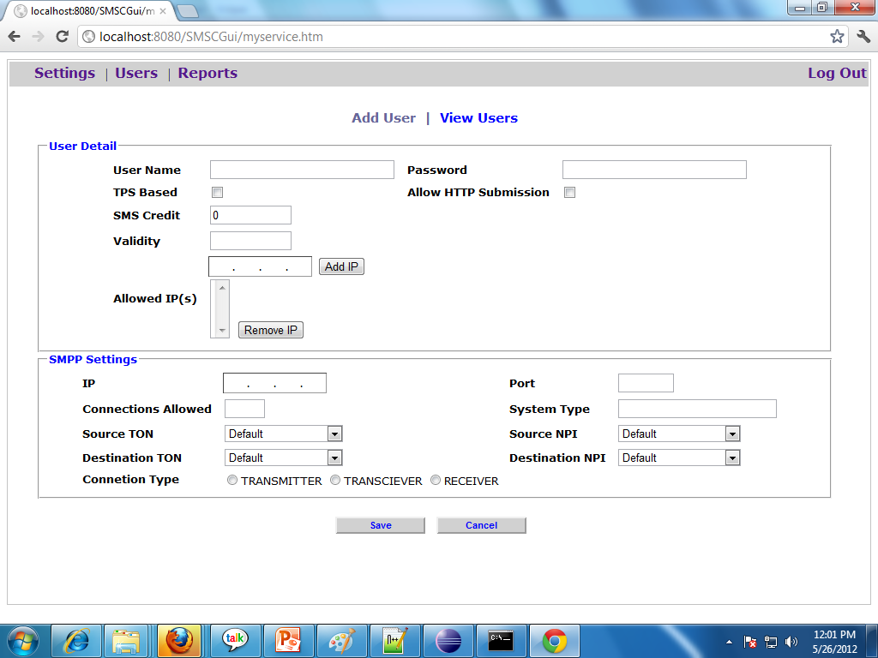
Add New User

Slide 13
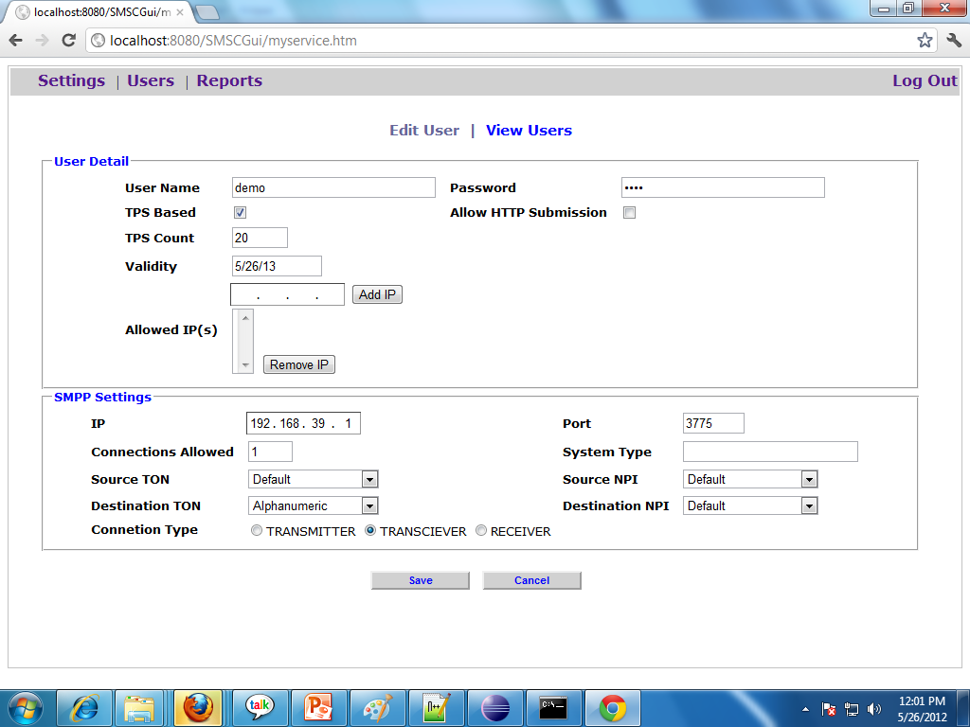
Edit User

Slide 14
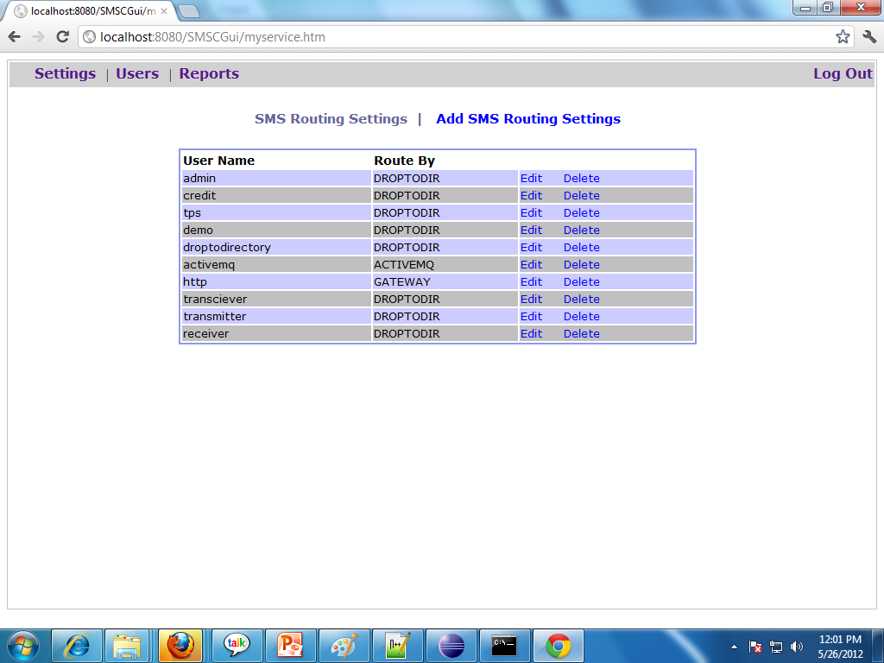
Settings

Slide 15
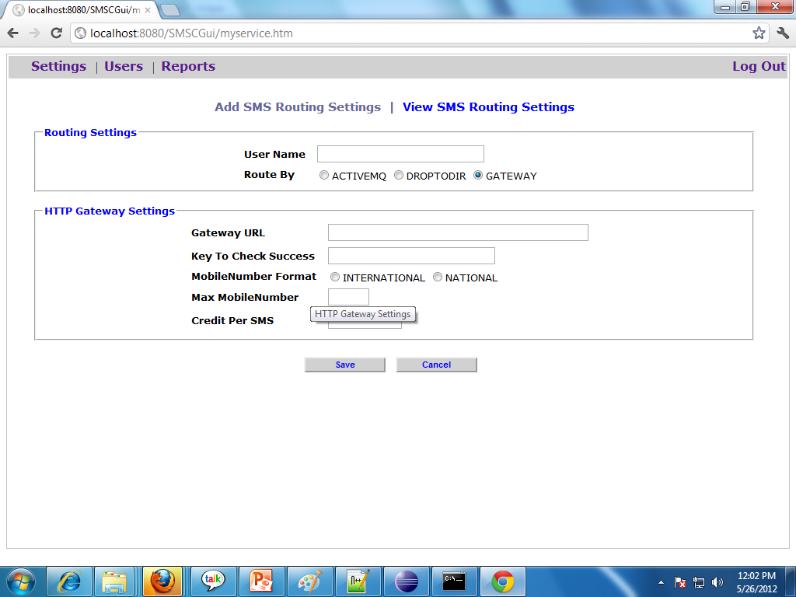
Add New Settings

Slide 16
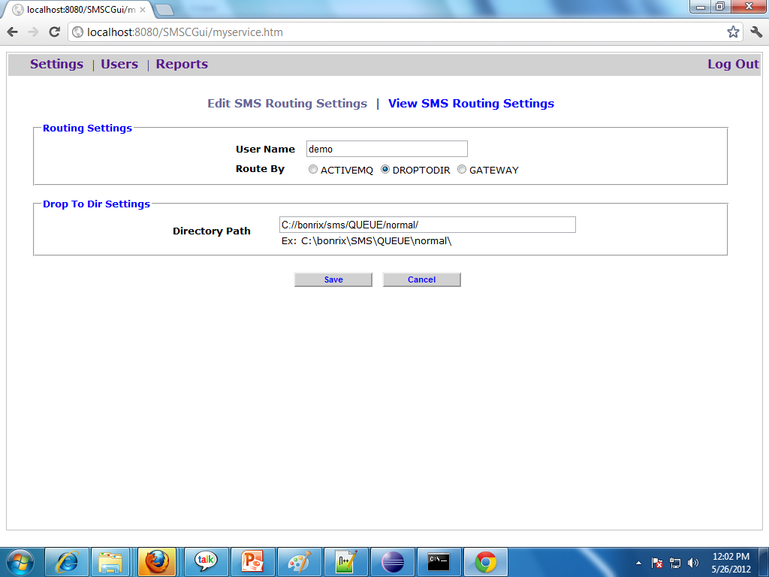
Edit Settings

Slide 17
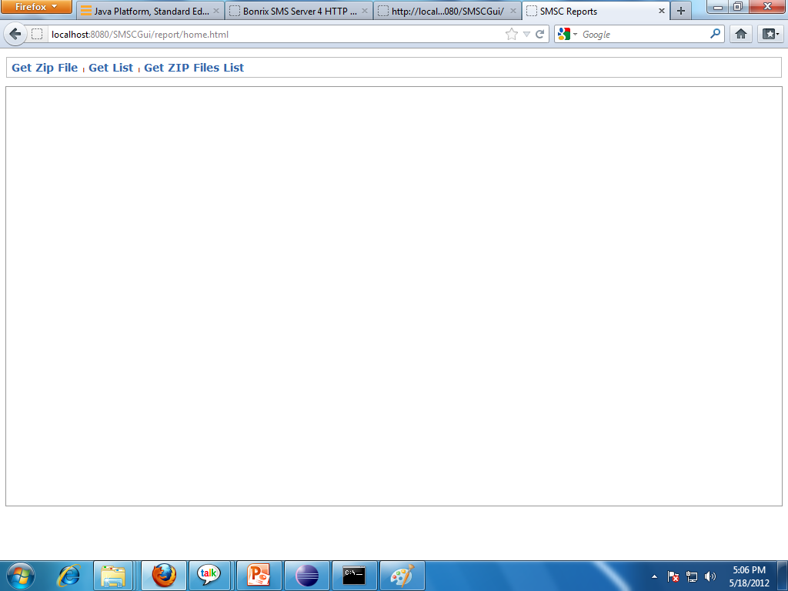
Report Home Screen

Slide 18
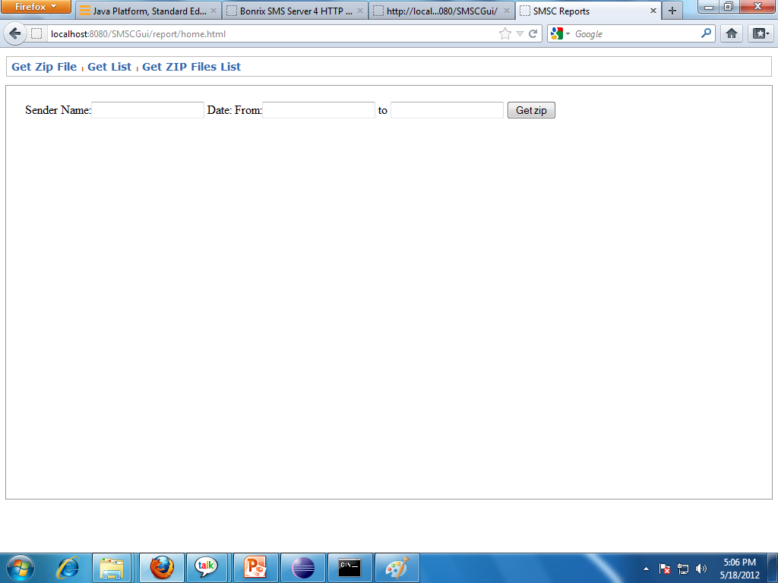
Report-Get Zip file as search result

Slide 19
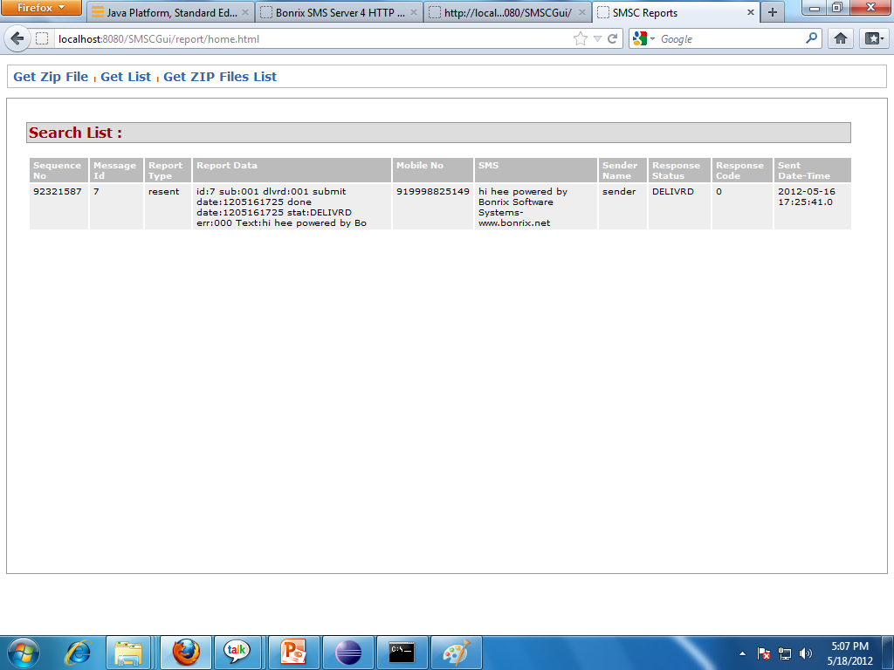
Report-Get Search Result as Table

Slide 20
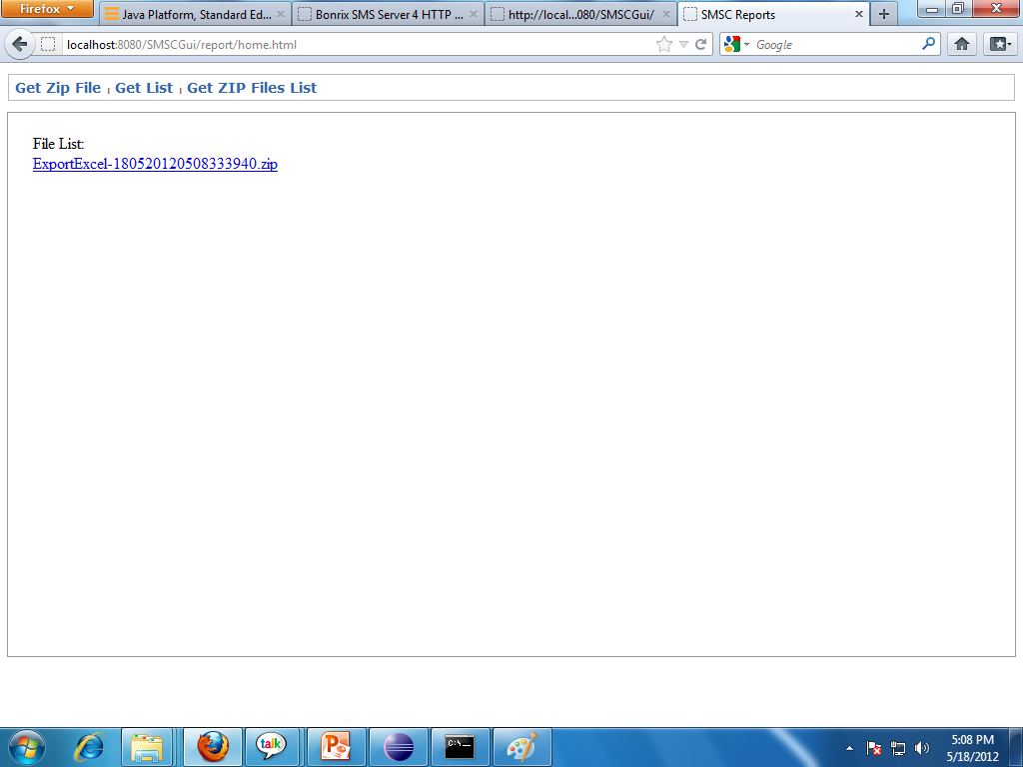
Report-Get Search Result as List of Downloadable Zip Files

Slide 21
HTTP API
To access HTTP API hit below URL with all parameters set from browser or from any application with HTTP GET.
http://<IP>:<PORT>/submit?username=<username>&password=<password>&message=<message>&sendername=<sendername>&mobilenumber=<mobilenumber>&deliveryreport=<deliveryreport>
Parameters Description:
<IP> : IP of Windows or Linux or any other machine.
<Port> : HTTP Port set in settings file(Default 88)
<username> : User Name given to client
<password> : Password given to client
<message> : Message content goes here
<sendername> : Client’s sendername
<mobilenumber>: Single or Comma(,) separated Mobile Numbers
<deliveryreport> : 1 if delivery report needed, 0 if not.
** No of comma separated mobile numbers limited to URL size.
System can handle any number of mobile numbers.

Slide 22
Settings
Bonrix SMS Gateway settings can be changed from TOMCAT_HOME/webapps/WEB_INF/classes/smpp.props
Smpp.props contains all the settings parameter related to smpp gateway
-It contains settings for number of smpp connection listeners.
-It contains settings for HTTP request handling.
-You can change SMPP and HTTP ports etc.
-And Many other operational parameters.

Slide 23
Features
SMS Submission :
1 - TPS(Transaction Per Second) based.
2 - Credit and Validity based.
SMS Routing :
-Third Party HTTP API
-Drop(Store) Messages in selected Directories
-Add messages to high speed messaging server[Active MQ].
Connection :
-TCP/IP
-HTTP API
High throughput and availability.
Low operational cost.

Slide 24
Users
User Name | Password | H | D | A | C | CC | TP | TC | T | TR | R
admin | admin | N | Y | N | Y | 100 | N | 0 | N | Y | N
droptodirectory | droptodirectory | N | Y | N | N | 0 | Y | 20 | N | Y | N
activemq | activemq | N | N | Y | N | 0 | Y | 20 | N | Y | N
http | http | Y | N | N | N | 0 | Y | 20 | N | Y | N
transmitter | transmitter | N | Y | N | N | 0 | Y | 20 | Y | N | N
transceiver | transceiver | N | Y | N | N | 0 | Y | 20 | N | Y | N
receiver | receiver | N | Y | N | N | 0 | Y | 20 | N | N | Y
tps | tps | N | Y | N | N | 0 | Y | 20 | N | Y | N
credit | credit | N | Y | N | Y | 100 | N | 0 | N | Y | N
demo | demo | N | Y | N | N | 0 | Y | 20 | N | Y | N
All users are given 1 year validity.
All users are allowed to do 1 connection only.
Below are Full forms of Short names used.
H=HTTP API D=Drop to directory A=Active MQ C=Credit User CC=Credit Count
TP=Tps TC=Tps Count T=Transmitter TR=Transceiver R=Receiver

